Slide 1

E-COMMERCE
DASHBOARD
REPORT
Ezekiel Lapastora
Xaltius Data Science Student

Slide 2
GENERAL
PROCESS
Problem Statement
Research Objective
Data Preparation
Report
Conclusions

Slide 3
Problem
Statement
The company is looking to create a customer base, enhancing the customer experience and recommend relevant products to the customers and increase revenue as per the information present.

Slide 4
Research
Objective
The objective is to generate a report with some important insights
which can be helpful for the company to better understand their
customers.

Slide 5
Data Preparation
This process involves cleaning the data, removing unnecessary information, combining relevant data, normalizing the tables, and data modeling.
I will not show every process, as it would require a large number of slides. Instead, I will focus on presenting the most significant ones

Slide 6
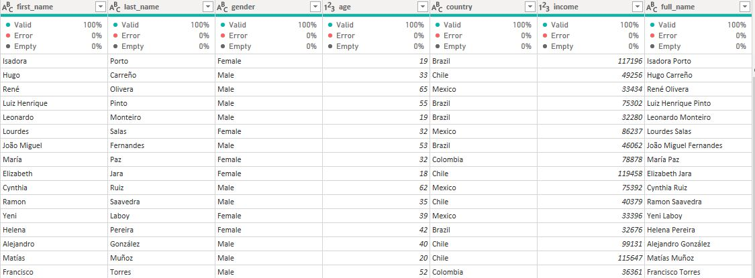
Data Preparation
Figure 1.1
I began the data cleaning process with the customer.csv file. Firstly, I merged the 'first_name' and 'last_name' columns using the 'Merge on Add Column' function, with a space delimiter, to create the 'full_name' column. Subsequently, I removed the 'first_name' and 'last_name' columns from the dataset to streamline the data.

Slide 7
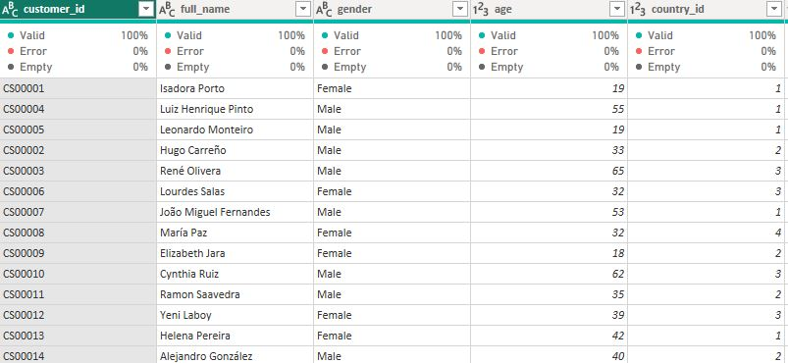
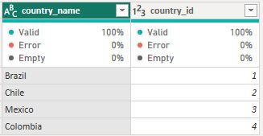
Data Preparation
Figure 1.2
During the data normalization process, I duplicated the 'customer' table and retained only the 'country' column. After removing duplicates and adding an index starting from 1, I merged this new table back into the 'customer' table using the 'country' column as the key. The final result was a 'customer' table with a 'country_id' column, representing the normalized 'country' data.

Slide 8
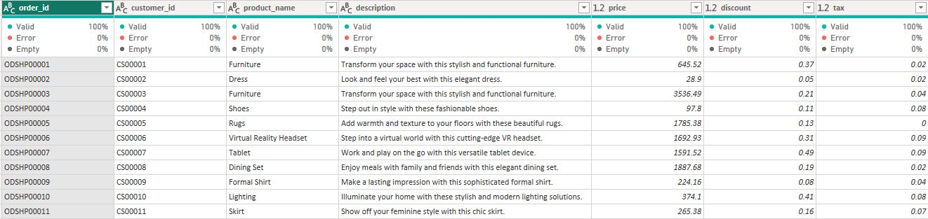
Data Preparation
Figure 1.3
I proceeded with the preparation of the main table, the purchase table. The major change made was the removal of the 'description' column. Additionally, I performed data normalization on the 'product_name' column, similar to what was done for the 'country' in the customer table. The remaining steps involved verifying correct data types and ensuring there were no null values, which fortunately were not present in the dataset.

Slide 9
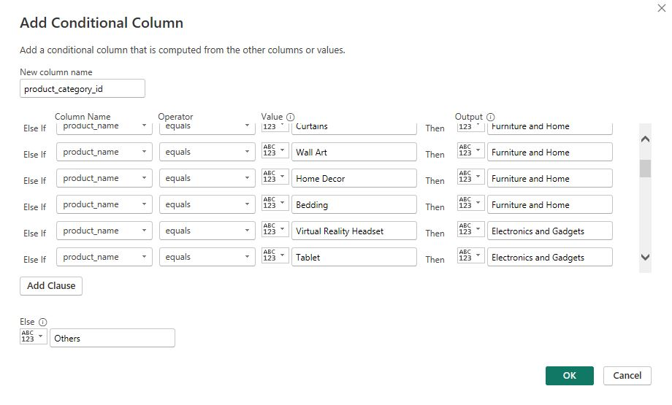
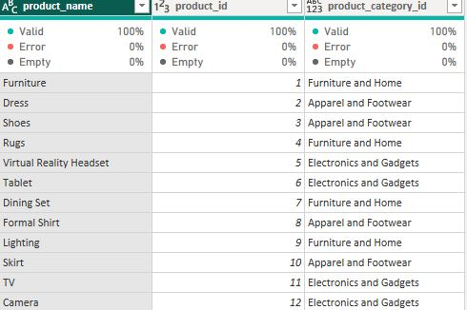
Data Preparation
Figure 1.4
I then processed the product table, which was created by normalizing the product data from the purchase table. I further categorized the products into three groups: Furniture and Home, Apparel and Footwear, and Electronics and Gadgets. Due to price discrepancies among the products within these categories, I decided to perform additional categorization. This led to the creation of the product_category table through another round of data normalization.

Slide 10
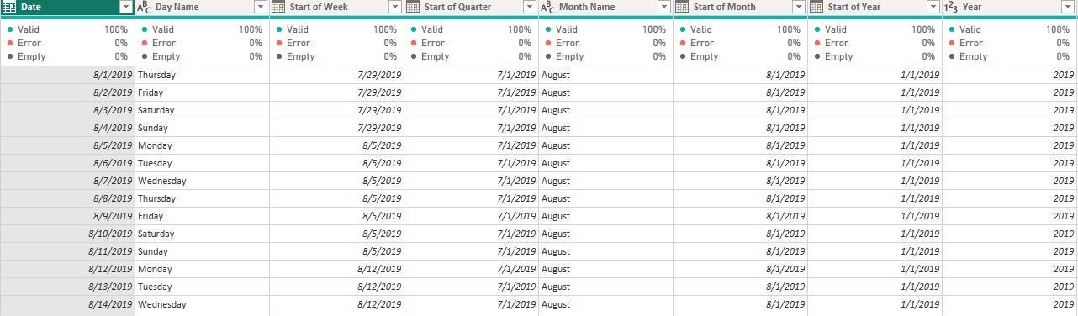
Data Preparation
Figure 1.5
The last significant process involved creating a rolling calendar lookup table using M-code, serving for both order data and shipping dates. A rolling calendar is a dynamic and adaptable calendar that automatically adjusts based on the dataset's time span. This approach ensures that the calendar remains up-to-date, synchronized, and efficiently handles time-related calculations and analyses. Having separate rolling calendars for order data and shipping dates enhances data consistency, integrity, and facilitates seamless time-based analysis. Overall, the implementation of rolling calendars through M-code provides a powerful and accurate tool for managing date-related operations and optimizing the analysis process for both aspects of the dataset.

Slide 11
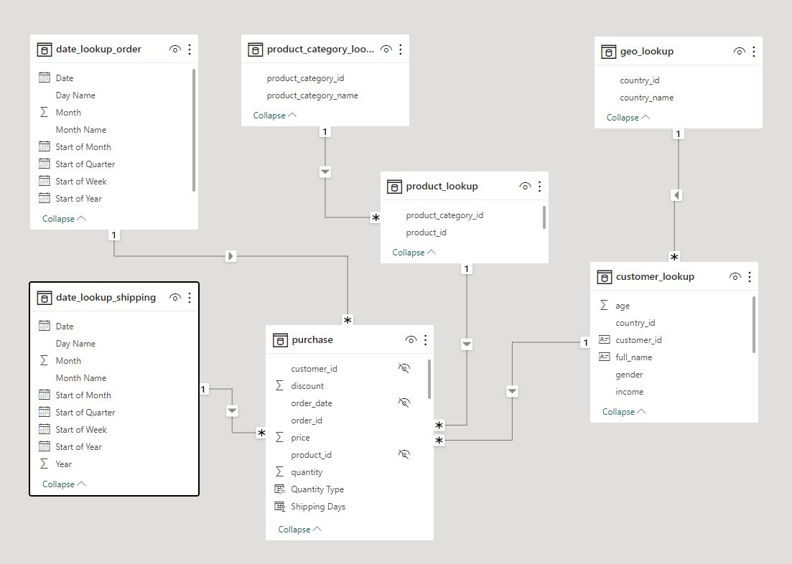
Data Preparation
Figure 1.6
This represents the final appearance of all the tables after thorough cleaning, processing, and establishing relationships among them.

Slide 12
Report
In this section, I will discuss the different dashboard summaries, including revenue, customer, and logistics. The primary focus of this discussion will be on the customer, as stated in the research objective. While I will touch on significant charts related to revenue and logistics, I will not cover every detail in these areas.

Slide 13
Report
Revenue Summary
Overview

Slide 14
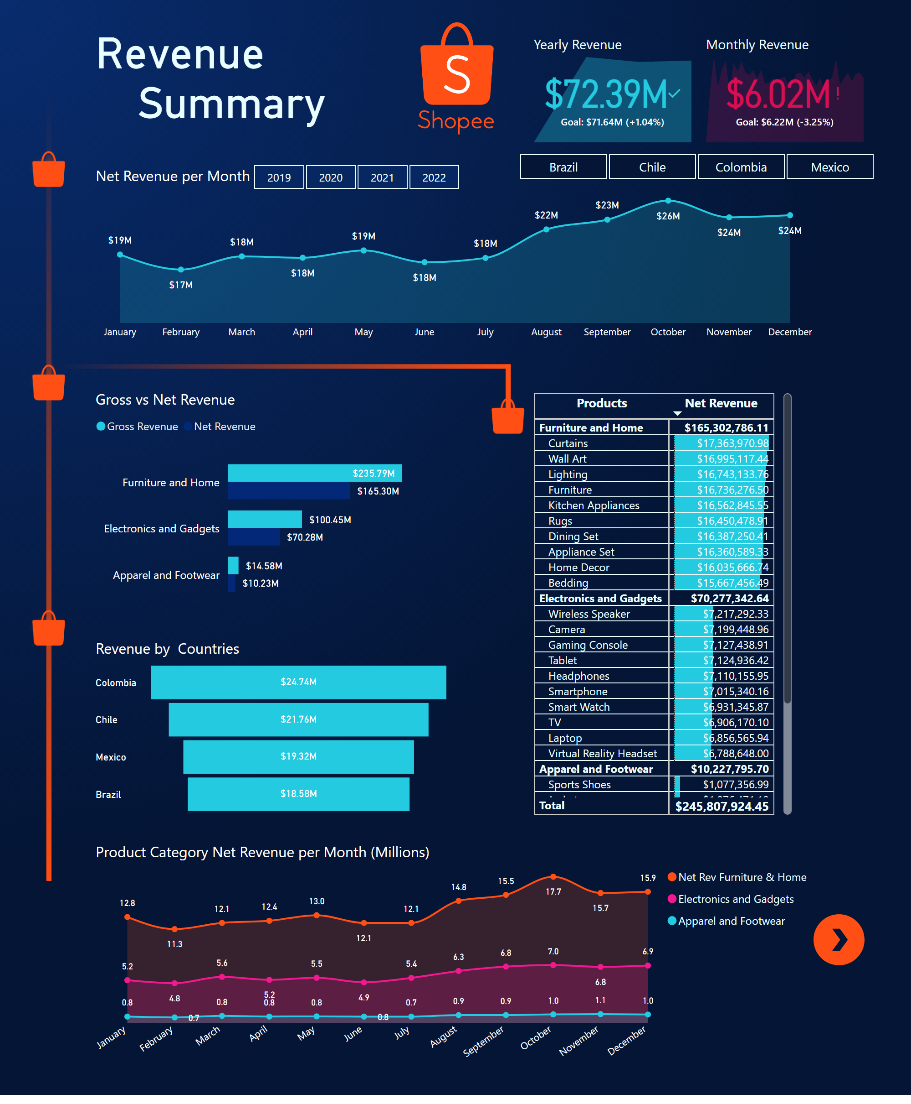

Slide 15
Revenue
Summary
In the Revenue Summary section, I will break down the significant charts, showcasing key performance indicators (KPIs) and trends for specific years. Additionally, I will highlight the products that generate the highest revenue.

Slide 16
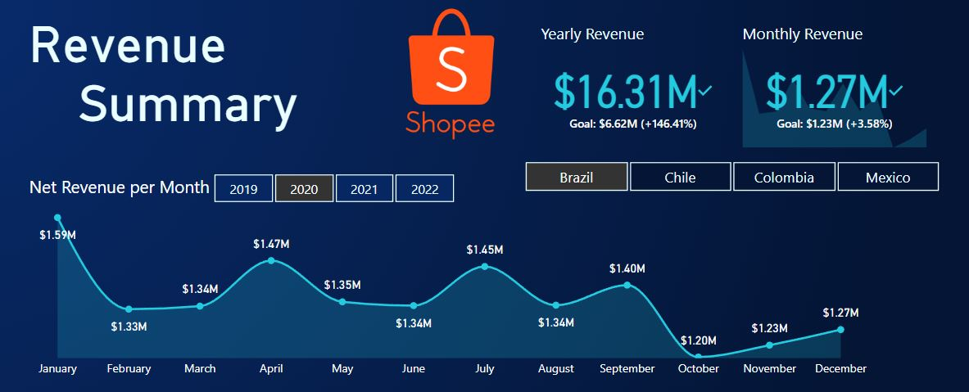
Revenue
Summary
Figure 2.1
Figure 2.2

Slide 17
Revenue
Summary
In Figure 2.1, we observe the overall behavior of the KPIs, with the company's revenue reaching $72.39M for the latest year and $6.02M for the latest month. Now, in Figure 2.2, when we specifically select the year 2020 and country Brazil, we can delve deeper into the revenue analysis for that country and year. Here, we find that the annual revenue for Brazil in 2020 amounts to $16.1M, with a monthly revenue of $1.27M. This focused view provides valuable insights into the revenue performance for the specified country and time period.

Slide 18
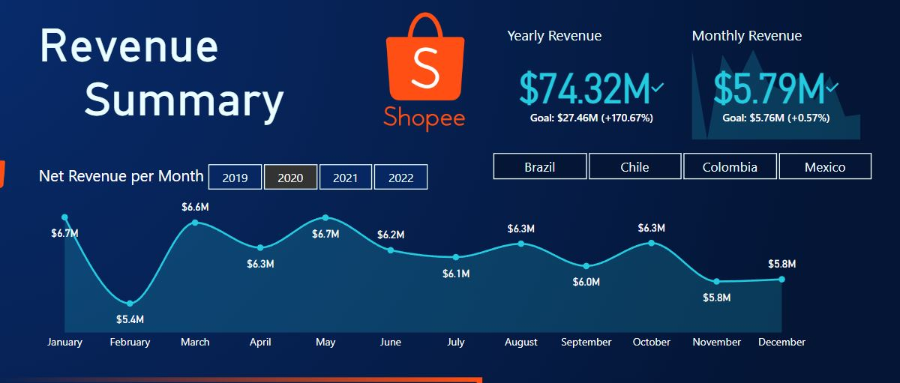
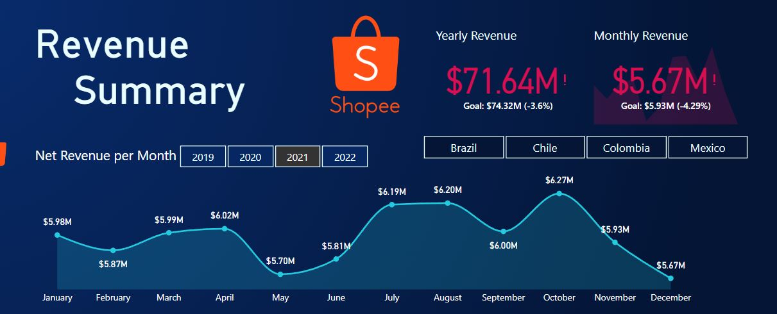
Revenue
Summary
Figure 2.3
Figure 2.4

Slide 19
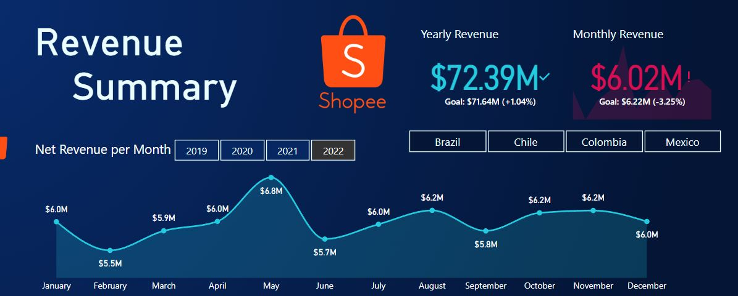
Revenue
Summary
Figure 2.5
In Figures 2.3, 2.4, and 2.5, we observe the company's revenue trends, with 2020 being the best-performing year and 2021 being the worst. Notably, the company's revenue dipped under $6M on seven occasions during 2021, compared to four times in 2022 and only three times in 2020. These visuals highlight the fluctuations in revenue over the years, providing valuable insights into the company's financial performance across different periods.

Slide 20
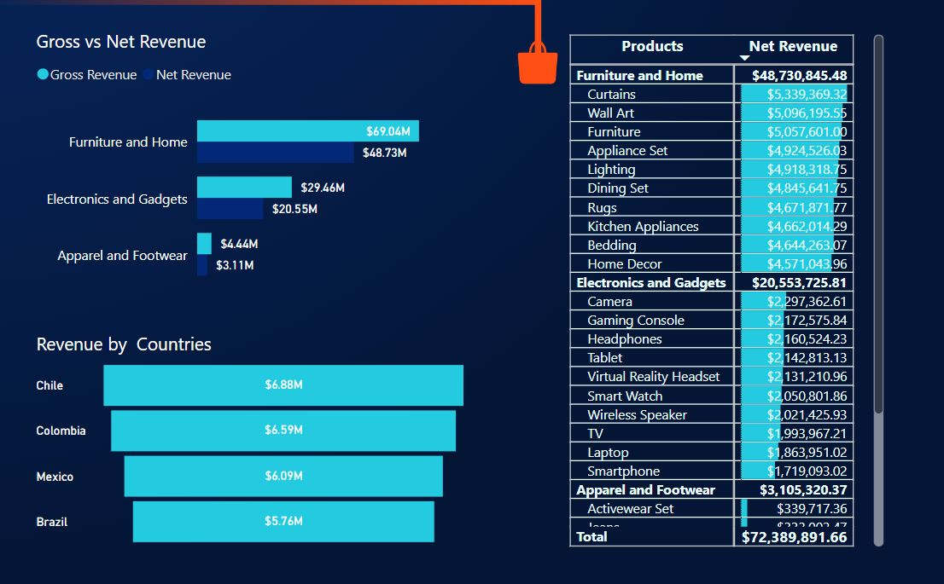
Revenue
Summary
Figure 2.6
Figure 2.6 presents the summary of revenue for product categories and countries. Notably, Furniture and Home emerges as the top-performing category in terms of net revenue, generating $69.04M. As for countries, Chile stands out as the country with the highest net revenue, reaching $6.88M, as of the latest date. This visualization offers a comprehensive view of the revenue distribution across different product categories and countries, allowing us to identify top-performing segments for further analysis and business strategies.

Slide 21
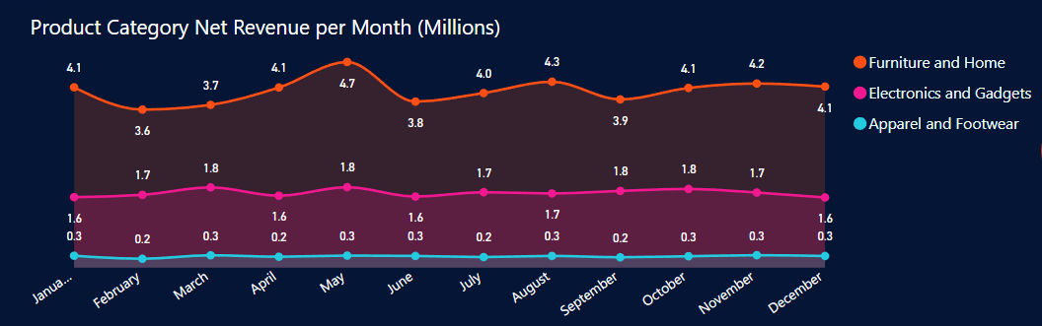
Revenue
Summary
Figure 2.7
Figure 2.7 displays the revenue trend for each product category in each month. Notably, the products under Furniture and Home category show a strong performance, reaching a year-end revenue of $4.1M. In contrast, the revenue generated by the apparel and footwear category is the lowest at $0.3M. This visualization provides valuable insights into the varying revenue trends across different product categories, allowing us to identify the top and lowest performing segments for further analysis and strategic decision-making.

Slide 22
Report
Customer
Summary
Overview

Slide 23
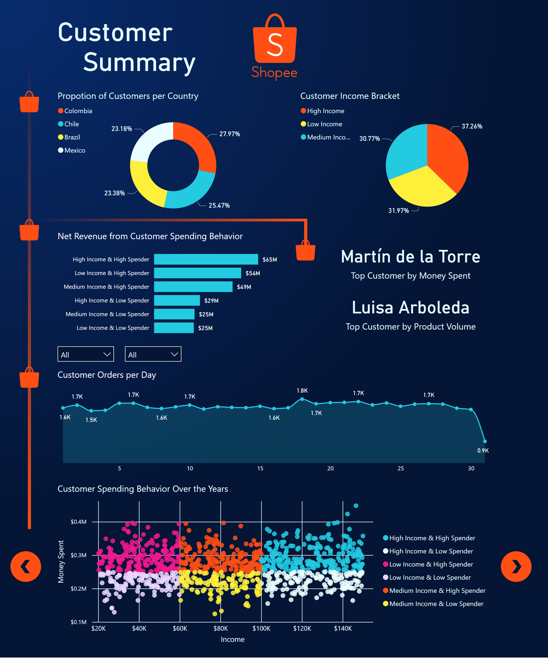

Slide 24
Customer
Summary
In the Customer Summary section, I will delve into the charts pertaining to customer analysis. These graphs offer valuable insights that help us understand customer segmentation based on their income and spending behavior. By examining these visuals, we gain a deeper understanding of our customer base, allowing us to make informed decisions and tailor our strategies to cater to different customer segments effectively.

Slide 25
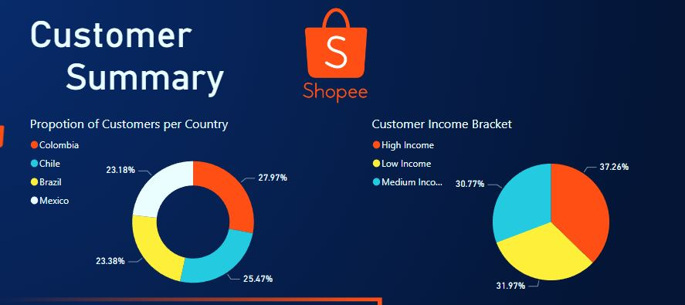
Customer
Summary
Figure 3.1
Figure 3.1 presents the geographical distribution of our customers, where we can observe that the majority, 27.97%, are from Colombia, while Mexico accounts for the smallest proportion at 23.18%. Additionally, the chart showcases the segmentation of customers based on their income. Surprisingly, the majority of our customers belong to the high-income bracket, comprising 37.26%, while the medium-income bracket represents the smallest share at 30.77%. This visual analysis provides valuable insights into our customer demographics, enabling us to target and tailor our services more effectively to different income groups and geographic regions.

Slide 26
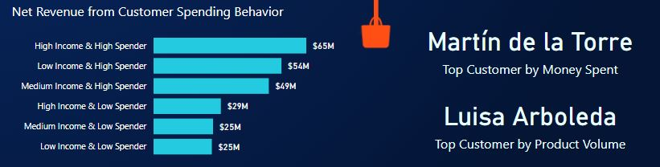
Customer
Summary
Figure 3.2
In Figure 3.2, I have segmented the customers based on their income and spending habits. To represent their money spent, I used the Gross Revenue minus the Discount Price, and in the subsequent section, I will delve into further insights on this aspect. Additionally, on the right side of the chart, I highlight the customers who spent the most money and those who made the most purchases. These findings present an opportunity for the company to strategize ways to reward these valuable customers and attract others to aim for similar rewards. By analyzing the spending behavior and identifying top-performing customers, we can optimize our marketing and loyalty programs to enhance customer satisfaction and drive business growth.

Slide 27
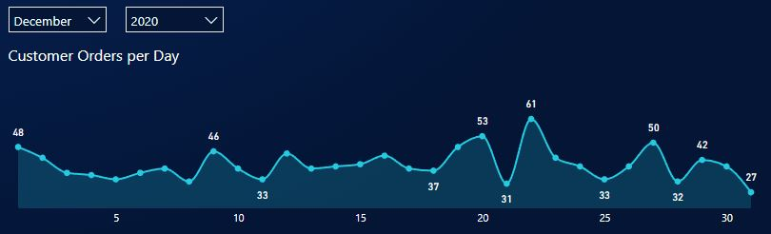
Customer
Summary
Figure 3.3
In Figure 3.3, we observe an area chart depicting the trend of the number of orders per customer per day, regardless of the quantity of items in each order. This visualization enables us to analyze customer ordering behavior and draw valuable insights. For instance, let's consider December of 2020. We can observe a significant surge in orders before and after the 25th of December, indicating a preparation for Christmas and the New Year. This valuable information can be utilized to our advantage in crafting targeted marketing campaigns that promote trending products during these festive occasions.

Slide 28
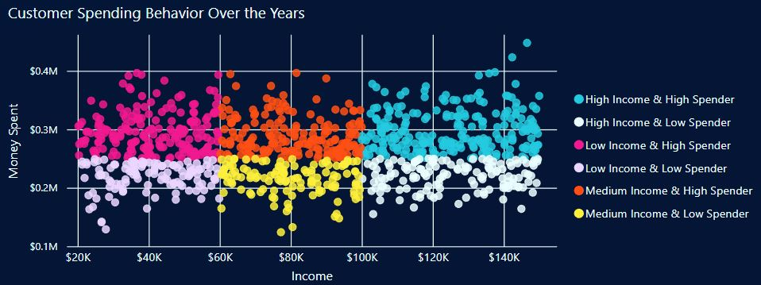
Customer
Summary
Figure 3.4
In Figure 3.4, I created a scatter plot of Income vs. Money Spent by customers. One observation is that the scatter plot follows a normal distribution pattern, indicating that income doesn't significantly influence the money they spend. This insight is valuable as it suggests that customers from lower income brackets can also be targeted with offers, deals, and sales, as their spending behavior remains unaffected by their income level. In the next slide, I will delve deeper into the strategies the company can employ based on customer spending behavior.

Slide 29
Customer
Summary
Figure 3.4
High Income and Low Spending
Customers in this segment of high income low spending are the highest priority. They have a high income but tend to spend less. They may have a higher purchasing power but might not be making frequent purchases or spending their money on our products or services. Targeting this segment with specific advertisements and marketing campaigns can help create awareness of products and encourage them to make more purchases. Highlighting the benefits, quality, and unique selling points of products can be effective in attracting their attention.

Slide 30
Customer
Summary
Figure 3.2a
High Income and Low Spending
Referring back to Figure 3.2a, we observe a significant difference in revenue generated between the high-income, low-spending customers and the high-income, high-spending customers for the year 2022. The former generated only $29M, while the latter contributed $65M in revenue. Despite income not directly influencing their spending behavior, it is crucial to recognize that these high-income, low-spending customers still possess considerable amount of money to spend. To better understand their preferences and habits, we can conduct further research on their hobbies, wants, and needs. Analyzing their engagement with our competitors' platforms and identifying their loyalty patterns can provide valuable insights for tailoring marketing ads that resonate with this particular customer segment, ultimately boosting customer engagement and driving higher sales.

Slide 31
Customer
Summary
Figure 3.4
High Income and High Spending
Customers in this segment have both high income and high spending behavior, making them valuable and loyal customers who already make significant purchases. It is crucial to maintain their loyalty and encourage repeat purchases. To enhance their customer experience and keep them engaged with the platform, we can offer exclusive rewards, personalized discounts, or early access to new products. For instance, we could provide them with premium services that are accessible only to this segment, creating an exclusive and personalized experience that fosters a sense of pride and status. By preserving their spending on our platform, we can strengthen their loyalty and reinforce their commitment to our brand.

Slide 32
Customer
Summary
Figure 3.4
Medium Income and High Spending
Customers in this segment with medium income but high spending behavior are noteworthy for their commitment to spending on our products despite their moderate income. To deepen their connection with the platform, we can implement additional strategies to reinforce their loyalty. Offering personalized rewards, exclusive discounts, and early access to new releases can entice them to continue their loyal patronage. Additionally, providing exceptional customer service and actively engaging with them through personalized communication can further solidify their trust and loyalty. By recognizing and appreciating their spending habits, we can nurture their loyalty and encourage them to become brand advocates, spreading positive word-of-mouth and attracting new customers to the platform.

Slide 33
Customer
Summary
Figure 3.4
Medium Income and Low Spending
Customers in this segment with a medium income tend to spend less and are price-sensitive. To encourage their purchases, the company can offer discounts, promotions, and special offers. Implementing limited-time offers, bundle deals, or loyalty programs can entice them to buy products and boost engagement with the brand. Additionally, providing monthly payment schemes and personalized loyalty rewards with points or cashback can further encourage repeat purchases. Creating a sense of urgency through flash sales and limited-time offers can prompt them to take advantage of discounts. By employing these strategies, the company aims to increase spending and foster lasting loyalty among the medium income, low-spending customer segment.

Slide 34
Customer
Summary
Figure 3.4
Low Income and High Spending
Customers in this segment have a low income but demonstrate high spending behavior, showcasing their engagement with the platform and a willingness to make regular purchases despite their income limitations. To effectively cater to their needs and preferences, the company can focus on offering products that align with their budget and interests. Providing affordable options, flexible installment plans, or loyalty benefits tailored to their spending patterns can further strengthen their loyalty to the brand. By understanding and catering to the unique requirements of this customer segment, the company can foster long-term relationships and sustain their high spending behavior.

Slide 35
Customer
Summary
Figure 3.4
Low Income and Low Spending
Customers in the low income, low spending segment display cautious spending behavior despite their limited income. However, an interesting insight is that their spending behavior is not significantly influenced by their income level. Even though they have lower purchasing power, some customers in this segment may still show occasional willingness to spend on the platform. To effectively cater to their needs and encourage engagement, the company can implement targeted strategies such as offering budget-friendly products, special discounts, or value bundles. Additionally, providing a convenient monthly payment option with low interest rates can further entice them to make purchases without straining their finances. Offering incentives like rewards points or cashback for each purchase can also encourage repeat purchases and foster lasting loyalty. By understanding that income doesn't significantly affect their spending behavior, the company can focus on providing products and offers that cater to their specific preferences and budget, aiming to increase engagement and spending among this customer segment.

Slide 36
Report
Logistics
Summary
Overview

Slide 37
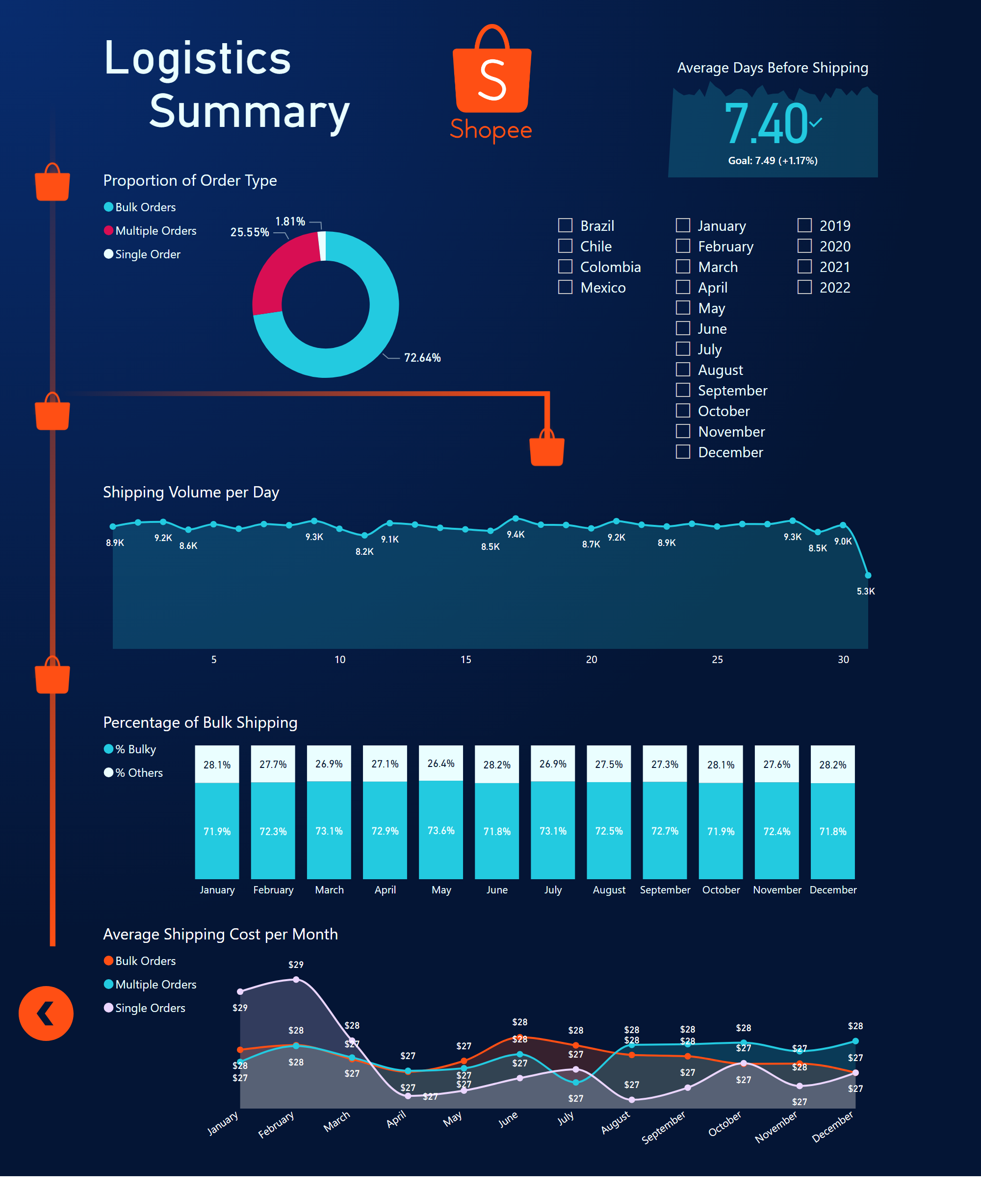

Slide 38
Logistics
Summary
In the Logistics Summary section, while there may be limited data available on logistics, we can still glean some valuable insights. Despite the scarcity of information, the data reveals a few noteworthy patterns and trends that can provide valuable guidance for the company's logistics strategies and operations.

Slide 39
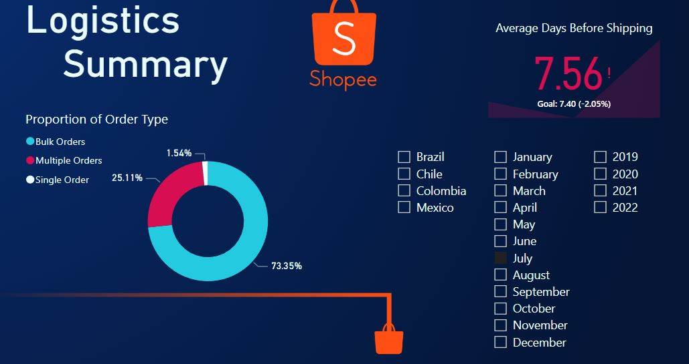
Logistics
Summary
Figure 4.1
In Figure 4.1, we can observe the composition of customers' orders, with 73.35% categorized as Bulk Orders. This indicates that a significant portion of customers is placing larger orders, optimizing logistics efficiency for both third-party and company-owned logistics. However, a concerning trend is the average time taken from order placement to shipping initiation, which exceeds 7 days. For instance, in July 2022, the average time was 7.56 days, indicating a slight deterioration compared to the previous month's average of 7.4 days. This delay in shipping initiation may negatively impact customer satisfaction and prompt the company to review and improve their logistics processes to ensure prompt order fulfillment.

Slide 40
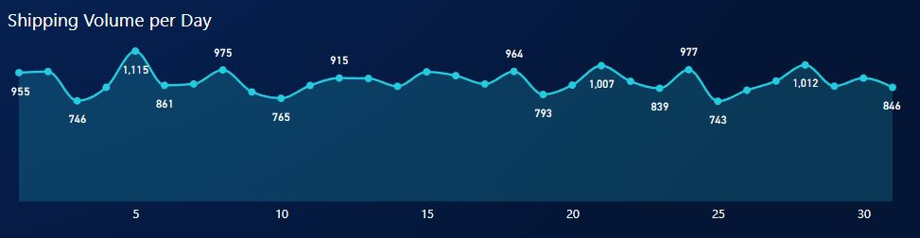
Logistics
Summary
Figure 4.2
In Figure 4.2, we can observe the daily volume of shipping for the month of December. This chart displays the total order quantities shipped per day across all the years in the data, excluding the year 2023. Analyzing the shipping volume on a daily basis can provide valuable insights into the company's peak shipping days, which can be useful for optimizing logistics operations and ensuring timely deliveries during high-demand periods. By identifying patterns in shipping volume, the company can proactively plan and allocate resources to meet customer demands more effectively.

Slide 41
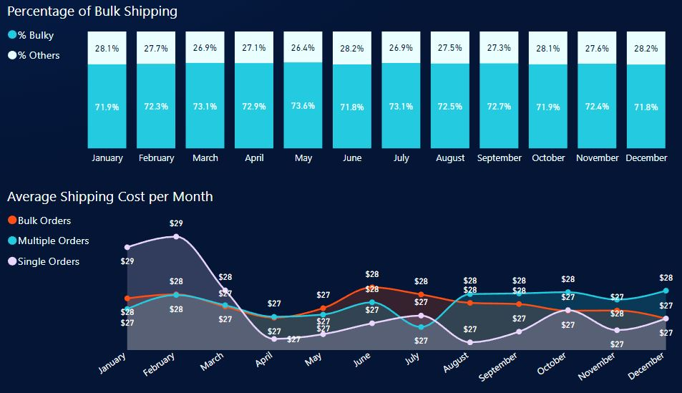
Logistics
Summary
Figure 4.3
In Figure 4.3, we can analyze the daily composition of the volume of shipping, where bulk orders dominate with an average of over 70%. This trend is beneficial for the company, as it indicates that customers are placing orders for a higher quantity of items per transaction. The high percentage of bulk orders suggests that the promotional offers and deals implemented by the company to encourage customers to make larger purchases are effective. This insight can guide the company in refining and expanding its promotional strategies to continue driving higher order quantities and increasing overall revenue.

Slide 42
Logistics
Summary
Figure 4.4
In Figure 4.4, we can analyze the area chart depicting the fluctuations in the average shipping cost per month for different types of order quantities, whether it's bulk, multiple, or single orders. Surprisingly, the shipping costs for these order types are relatively close to each other. For example, in December, the average shipping cost for single orders is $27, while for bulk orders, it's just slightly higher at $28. This strategy of keeping shipping costs relatively consistent across different order quantities could be a deliberate effort to incentivize customers to place larger orders, maximizing the shipping cost per transaction. Moreover, this approach may also help the company offset any potential losses incurred during the shipping of single orders, contributing to a more balanced and profitable logistics model.

Slide 43
Conclusions
In this section, we will discuss the final insights from the charts and data analysis, along with some recommendations.

Slide 44
Conclusions
Customer Segmentation: Our analysis identified three main customer segments based on income and spending behavior: "High Income and High Spending," "Medium Income and High Spending," and "Low Income and High Spending." Notably, income does not significantly influence customer spending behavior, allowing targeted marketing strategies to be employed across income brackets.
Revenue Trends: Our revenue analysis revealed fluctuations over the years, with 2020 being the best and 2021 experiencing a dip. The company can focus on implementing strategies to boost revenue during slower periods, such as limited-time offers and flash sales.

Slide 45
Conclusions
Product Category Performance: The Furniture and Home category emerged as the highest revenue generator, while Apparel and Footwear generated comparatively lower revenue. The company can further promote the Furniture and Home category to capitalize on its popularity.
Logistics Optimization: The majority of orders are Bulk Orders, indicating customers' preference for purchasing multiple items in a single order. The company's efficient logistics support this behavior. However, improvements in reducing the average shipping time can enhance customer satisfaction.

Slide 46
Conclusions
Customer Engagement: Engaging customers through targeted marketing, personalized offers, and loyalty rewards can foster lasting loyalty. The "High Income and Low Spending" segment offers potential for growth, as their high income may indicate untapped spending potential.

Slide 47
Recommendations
Customer-Centric Approach: Prioritize customer-centric strategies to cater to the diverse needs of different customer segments. Focus on delivering exceptional customer experiences, which can lead to increased customer retention and advocacy.
Personalization: Leverage customer data to deliver personalized offers, product recommendations, and marketing messages. Personalization enhances customer engagement and can boost conversions.
Loyalty Programs: Implement loyalty rewards and cashback programs to encourage repeat purchases and foster customer loyalty. Exclusive rewards and benefits can entice customers to return and remain loyal to the brand.

Slide 48
Recommendations
Promotional Campaigns: Plan targeted marketing campaigns during seasonal peaks, holidays, and special occasions to drive customer engagement and spending. Utilize data insights to identify trending products and align promotions accordingly.
Continuous Analysis: Regularly analyze customer data, revenue trends, and logistics performance to identify opportunities for improvement. Monitor customer behavior and preferences to adapt marketing strategies and enhance customer satisfaction.

